Slide 1
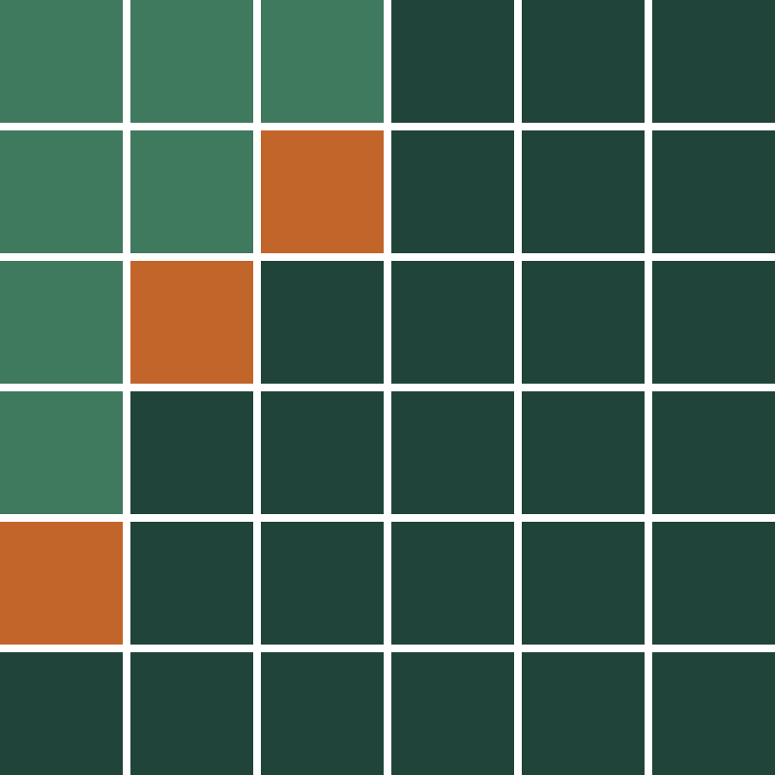
System Earth Business Case Project
EUDR · IVORY COAST COCOA
EUDR verification for Ivory Coast cocoa: a compact, query-fast store that reproduces every plot verdict
Rafael · Hack&Hire hackathon · 17 Oct 2026
Notes:
One sentence to open: we built a store 43 times smaller than the raw layers that answers plot checks about 16 times faster than Earth Engine, re-checks only what changed, and matches the raw-layer verdicts on every plot. Then go straight to why Ivory Coast cocoa.

Slide 2
Field jargon
KEY TERMS
EUDR
EU Deforestation Regulation (2023/1115): cocoa, coffee, rubber and other goods sold in the EU must not come from land deforested after 31 Dec 2020. Applies from 30 Dec 2026
JRC GFC2020
Hansen GFC
The EU Joint Research Centre’s Global Forest Cover map: where forest stood on 31 Dec 2020, the EUDR cut-off
Global Forest Change, University of Maryland: the year tree cover was lost, from Landsat, updated yearly
RADD
WDPA
Radar for Detecting Deforestation, Wageningen University: weekly alerts of new disturbance from Sentinel-1 radar, which sees through cloud
World Database on Protected Areas, UNEP-WCMC and IUCN: the official boundaries of parks and reserves
Dark: the regulation · green: the 2020 baseline · orange: disturbance after it · blue: protected areas
2
Notes:
Optional, about 15 seconds. Don’t read every card. How to say it: “A few terms first. EUDR is the EU rule: nothing sold in the EU may come from land deforested after the end of 2020, and it applies from 30 December. Four public datasets let us check that. GFC2020 is the EU’s own map of where forest stood at the end of 2020, the cut-off. Hansen and RADD tell us what was disturbed after that: Hansen yearly from optical satellites, RADD weekly from radar, which sees through cloud. And WDPA gives us the park boundaries.” If a judge asks about a layer later, point back to this slide; slide 7 shows what we keep from each one.

Slide 3
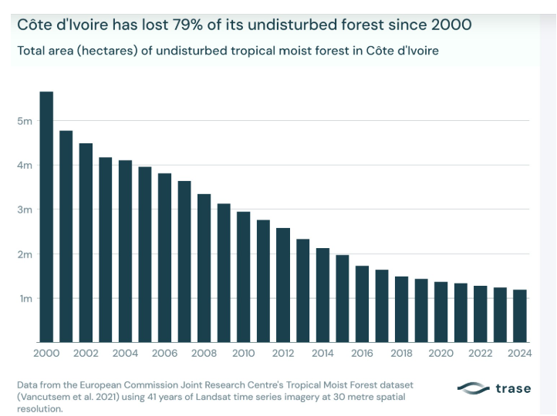
Two-thirds of Ivory Coast’s cocoa exports go to the EU, and EUDR applies in 74 days
WHY IT MATTERS
79%
of undisturbed forest lost or degraded, 2000–2024; cocoa drove about 45% of loss
36%
of the world’s cocoa beans are grown in Ivory Coast (FAO, 2024)
66%
of Ivorian cocoa exports go to the EU, a record (2024)
≥ 4%
of EU turnover: maximum EUDR fines, plus confiscation and market bans
Standard risk: every plot is checked
Each plot geolocated and checked against the 31 Dec 2020 cut-off, from 30 Dec 2026.
Sources: Trase (2026); FAO; Reg. (EU) 2023/1115 Art. 25, 2025/1093, 2025/2650
3
Notes:
Start with the land, then the law. About 45 seconds. The chart is Trase’s, from the EU Joint Research Centre’s satellite record: since 2000 Ivory Coast has lost or degraded 79% of its undisturbed forest, from about 5.6 to about 1.2 million hectares. Cocoa expansion drove about 45% of forest loss over 2003 to 2017. What’s left is mostly protected: in our study area, forest in 2020 is almost entirely Taï National Park, with cocoa farms right up to its edge. Now the market. Ivory Coast grew 36% of the world’s cocoa beans in 2024, and a record 66% of its exports go to the EU. From 30 December, 74 days from today, large and medium EU operators must prove every lot was not grown on land deforested after 2020. Ivory Coast is standard risk, so there is no simplified route: every plot gets a geolocated check. And a failed check is expensive: maximum fines of at least 4% of EU turnover, plus confiscation and temporary market bans. If asked about the older 59% EU share: that was an EU factsheet for 2023; Trase’s 2024 figure is 66%.

Slide 4
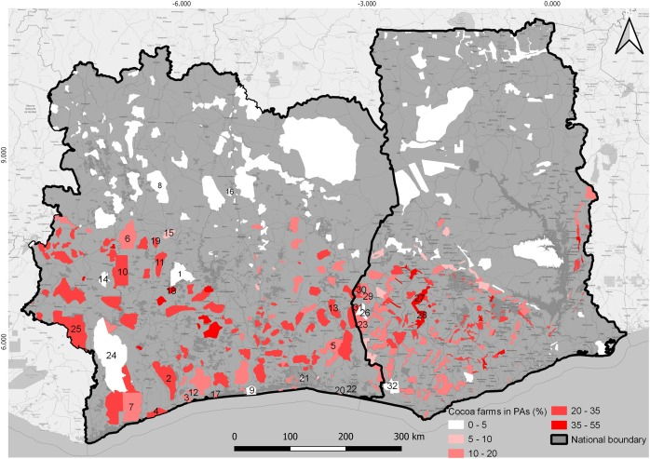
Small plots: the hardest test of decision fidelity
WHY THIS CASE
Small plots, few cells
Over 1 million farmers on about 3.2M ha. A 1 ha plot is only ~120 cells, and 3 disturbed cells (≈ 0.026 ha) can flag it.
The edge decides
About a third of the cells a 1 ha plot touches are cut by its boundary. Both pipelines must apply the same pixel rule, or verdicts flip.
Points, not polygons
Under 4 ha, EUDR accepts one GPS point; we buffer it to the declared area. 157 of our 500 test plots are points.
Farms inside and beside forest
Cocoa reaches into many protected areas (map), so plots border forest, where one or two cells change the answer.
Map: cocoa share of protected areas (Kalischek et al., 2023) · farmers: Conseil du Café-Cacao via EFI (2024)
4
Notes:
Why we chose Ivory Coast cocoa: it’s the hardest test of the thing the judges score, decision fidelity. The plots are tiny. Over a million farmers work about 3.2 million hectares, around 3 hectares each. On the 9.2 metre forest grid, a 1 hectare plot is only about 120 cells, and our rule flags a plot at 3 disturbed cells, about 0.026 hectares. So every cell matters. Of the 144 cells a 1 hectare plot touches, 44, about a third, are cut by its boundary, and the pixel-centre rule decides each one. If the compact store and the raw pipeline handled even a few edge cells differently, small plots would flip verdicts. That’s why 100% decision fidelity on plots this small means something. Many plots aren’t even polygons: under 4 hectares, EUDR accepts a single GPS point, so we buffer it to a circle of the declared area. 157 of our 500 test plots are points. And the map shows where they are: cocoa reaches deep into protected areas, in some parks more than a third of the area, so plots sit right against forest, where one or two cells change the answer. SystemEarth’s sample is Thai rubber; we picked the case that stresses fidelity hardest, and kept their output schema.

Slide 5
How SystemEarth works today
TODAY’S WORKFLOW
Plots + CSV
Compare
Verdict
Supplier
GeoJSON and due-diligence
Earth Engine analysis
with the declaration
reanalysis on demand or schedule
submits a lot
over stored layers
Vectors
Rasters
Analysis
Plots and boundaries in PostGIS
Full copies in Google Cloud Storage, served via GeoServer
Earth Engine, commercial Enterprise Basic plan
Already strong, and we keep it
Where we focus
Dataset versions and a full audit trail per plot and analysis; their output schema.
Speed per check, storing full raster copies, and knowing which past lots a new release can affect.
Source: SystemEarth product manager, 14 Oct 2026
5
Notes:
This is how SystemEarth works today, from their product manager on 14 October. The customer submits plots and a due-diligence CSV. SystemEarth analyses the plots in Earth Engine against its stored layers and compares the result with the supplier’s declaration. The stack: vectors in PostGIS, rasters as full copies in Google Cloud Storage served through GeoServer, and analysis on Earth Engine under a commercial Enterprise Basic plan. Past lots are not re-checked automatically. Users choose manual or scheduled reanalysis, and sometimes skip it, for example when deforestation happened after the harvest. They already record dataset versions and keep a full audit trail, so reproducibility is not our pitch. We kept that and their output schema, and targeted three things: speed per check, storing full raster copies, and knowing exactly which past lots a new release can affect.

Slide 6
Tree cover loss is not deforestation (legally speaking)
THE DECISION RULE
Example plot | Satellite sees | 2020 forest bit | Our rule | Verdict
Shade cocoa, trees thinned in 2023 | Tree-cover loss | 0 · farmland | Ignored: not on 2020 forest | Compliant
Forest cleared for cocoa in 2022 | Tree-cover loss + radar alert | 1 · forest | Counted: 3+ cells, strong signal | Non-compliant
Edge: weak alert or 1–2 cells | Low-confidence alert | 1 · forest | Small or weak signal | Needs review
99.5%
22.9% → 0.12%
Where it can still miss
of post-2020 tree-cover loss outside parks fell on land that wasn’t forest in 2020
GFC2020 sometimes maps shade cocoa as forest (18% commission error, v2). Weak or tiny signals go to a person.
of 5,000 random 2 ha farms flagged: Hansen-only vs gated by 2020 forest
The decision rule, not the storage · Example plots illustrative · EUDR Art. 2(4)–(5); JRC GFC2020
6
Notes:
A judge will ask: shade cocoa can look like forest from orbit, so how do we tell them apart? Our system never decides from the picture. EUDR defines forest by land use, not by trees. Land predominantly under agricultural use, including plantations, is not forest, however tall the trees. So the question is never “does this look like forest today”, it is “was this land forest on 31 December 2020”. The EU’s GFC2020 map answers that per 10 metre pixel: it starts from all 2020 tree cover and removes cropland, agroforestry and tree crops such as cocoa. We keep that answer as one forest bit per cell, and only count disturbance where the bit is 1. Three example plots. Shade cocoa whose shade trees are thinned: the satellite sees loss, but the cell was farmland in 2020, so it’s ignored: Compliant. Forest cleared for cocoa: three or more cells with a strong signal: Non-compliant. A weak alert or one or two cells: Needs review. Measured in our area: 99.5% of post-2020 tree-cover loss outside the parks was on land that wasn’t forest in 2020, so a Hansen-only check flags 22.9% of random farms and ours flags 0.12%. That’s why Hansen-only checks send farms to field visits; the supplier in SystemEarth’s own sample flagged 5 of 17 plots and cleared them on site. Be upfront: this gain comes from the decision rule, not the storage. And it can still miss: GFC2020 sometimes maps shade cocoa as forest, 18% commission error in version 2, which is why weak or tiny signals go to review. We remove flags; we don’t prove them false.

Slide 7
What the decision actually needs
LAYER ANALYSIS
Layer | Keep | Drop | Why
JRC GFC2020 v4 | 1 bit: forest on 31 Dec 2020 | — | The cut-off baseline (EUDR Art. 2)
Hansen GFC v1.13 | Loss year 2021–2025, only on 2020 forest | treecover2000, loss before 2021, imagery bands | Earlier loss cannot change the verdict
RADD alerts | First post-cut-off date + confidence, only on 2020 forest | Alerts before 2021 | Dates matter only after the cut-off
WDPA | National protected areas, clipped | International designations (inside the park here) | Avoid double counting
All layers on the GFC2020 grid: ≈ 9.2 m cells, ≈ 85 m² each. RADD resampled by nearest neighbour, identically in both pipelines. GLAD-L left out: same Landsat source as Hansen.
Source: decision spec
7
Notes:
Every dropped layer has a reason. The rule only asks: was this cell forest on 31 December 2020, and was it disturbed after? So we keep one bit from GFC2020, and only post-cut-off disturbance on 2020 forest from Hansen and RADD. Everything is put on the GFC2020 grid, about 9.2 metre cells, about 85 square metres. Hansen aligns exactly as 3 by 3 cells. RADD sits on its own grid and is resampled by nearest neighbour; both pipelines do it identically, so it cannot cause a fidelity difference. WDPA: we keep national designations. The Taï World Heritage record lies inside the national park, so including it would only double count. GLAD-L alerts are left out because they come from the same Landsat source as Hansen.

Slide 8
Four paths, each run only as often as it must
ARCHITECTURE
Per release
Extract
Encode
Record
3.9 s encode · 22.7 kB event file
weekly to yearly
EE export or download
16-bit base or event file
Manifest: versions, hashes
Per lot upload
Points → circles
Index cells
Overlay parks
≈ 148 bytes per plot
once per plot
Of the declared area
Run-length cell runs
d1 / d2 overlaps, stored
Per check
on demand or scheduled
Read cell runs
Read one tile
Apply rules
32 ms · 0.9 kB read
From the plot index
Decode 16-bit cells
SQL in DuckDB
Per update
Changed cells
Affected plots
Re-check those
39 of 500 plots · 0.11 s
after each release
From the event file
Join with the index
Report changed verdicts
Store: 16-bit base raster · event file per release · plot index · manifest · blue = measured
8
Notes:
The architecture is four paths, and the design principle is that each runs only as often as its inputs change. Earth Engine is used only to extract a release, not for every check. Per release, weekly for RADD or yearly for Hansen: extract the layers, from an Earth Engine export or a direct download; encode them into the 16-bit base raster or a small event file; record versions and file hashes in the manifest. Encoding took 3.9 seconds for our area; a release’s event file was 22.7 kB. Per lot upload, once per plot: point plots become circles of their declared area, polygons become run-length cell runs, and park overlaps for d1 and d2 are computed and stored. About 148 bytes per plot. Per check, the hot path, in orange: read the plot’s cell runs, read the one tile they fall in, decode the 16-bit cells, apply the rules in SQL. 32 milliseconds, under a kilobyte read. No geometry anywhere on this path. Per update: take the cells in the new event file, join them against the plot index, and re-check only the plots they touch. 39 of 500 in 0.11 seconds. The store itself is four kinds of file: the 16-bit base raster (forest bit, 3 source bits, 12-bit first-disturbance date), one event file per release, the plot index, and the manifest of dataset IDs, versions and hashes.

Slide 9
Keep 16 bits per cell: 43× smaller
STORAGE EFFICIENCY · RESULT AND RATIONALE
140 kB
43×
≈ 50 B
≈ 148 B
compact store, all decision layers
smaller than 6.05 MB of raw layers, compressed
per km² of decision layers
per plot in the plot index
We chose | Why | Trade-off
16 bits per cell | Forest bit + 3 source bits + 12-bit date is all the rule reads | New questions mean re-extracting; the manifest says what
GFC2020 pixel grid, not H3 | Hexes don’t align with pixels; plot membership would change | The store is tied to one baseline grid
ZSTD, no predictor | 96 kB vs 111 (predictor), 191 (DEFLATE), 370 kB (LZW), all measured | Slow level-19 write, once per release
Event file per release; RLE plot index | An update is a 22.7 kB file; index 70 kB vs 977 kB per cell | Event log grows: fold into the base quarterly
50 × 50 km area (2,756 km²), 500 plots · compared with raw layers as exported and compressed
9
Notes:
Storage, with the reasons behind it. The result: 140 kB for all decision layers against 6.05 MB of raw layers as exported and compressed, 43 times smaller. About 50 bytes per square kilometre, and about 148 bytes per plot in the plot index. Do not quote 1,935 times: that compares against uncompressed layers and is inflated because RADD was exported as int32. Why it is that small. The rule only reads whether a cell was forest in 2020, which source fired, and the first disturbance date, so each cell is one 16-bit number. The cost: a new question, like degradation or a different cut-off, means going back to the source; the manifest records exactly what to re-fetch. We store on GFC2020’s own pixel grid, not H3: hexagons don’t align with pixels, so they would change which cells count as inside a plot and pixel fidelity would break. On the pixel grid, Hansen also aligns exactly as 3 by 3 cells. Compression was measured: ZSTD without a predictor is 96 kB, with a predictor 111, DEFLATE 191, LZW 370; differencing scrambles bit-packed fields. Each release is a small event file, 22.7 kB, instead of rewriting the base, and plots are run-length cell runs, 70 kB instead of 977. The event log grows, so it is folded into a fresh base quarterly. Honest framing: storage is cheap in money either way. SystemEarth stores full raster copies today; the decision needs about 2% of those bytes. Small storage matters because it makes fast local checks possible: one plot reads one tile.

Slide 10
Do the geometry once: 32 ms per check
QUERY PERFORMANCE · RESULT AND RATIONALE
32 ms
0.34 s
Same
3.9 s
one plot, 1 tile, 0.9 kB read (Earth Engine: 0.51 s)
500 plots (Earth Engine batched: 7.9 s)
c2 result as Earth Engine on all 500 plots
encode step per release: the price
We chose | Why | Trade-off
Plot → cell runs at upload | No geometry at query time; a check is lookups | ≈ 148 bytes per plot, built at upload
Park overlaps at upload | Boundaries rarely change, so overlay leaves the query path | Recompute when WDPA updates
512 px tiles | About one tile per plot | 256 px saves bytes but adds reads
DuckDB, local, serverless | No 20-request cap, no server to run | One machine; start-up is most of the 32 ms
Earth Engine: median of 20 single requests (range 0.40–6.9 s) and one batched run
10
Notes:
Query speed, with the reasons behind it. The result: one plot in 32 milliseconds, reading one tile and under a kilobyte, against a median of 0.51 seconds for one Earth Engine request, with a long tail up to 6.9 seconds. That is about 16 times faster per plot. 500 plots in 0.34 seconds against 7.9 seconds for one batched Earth Engine request. And it is the same answer: c2 identical on all 500 plots. The price is an encode step per release, 3.9 seconds for our area. Why it is fast: we move work out of the query path. When a supplier uploads plots, each polygon becomes run-length cell runs once, so a check needs no geometry, only lookups. Park overlaps are computed once per plot at upload because boundaries rarely change; when WDPA updates, they are recomputed. 512 pixel tiles mean about one tile per plot; 256 would save bytes but add reads. And the engine is DuckDB on local files: no concurrency cap like Earth Engine’s 20 requests, no server to run. Most of the 32 milliseconds is start-up overhead that a long-running service would remove. Earth Engine compute for reference: 0.17 EECU-seconds per single request, 0.036 per plot when batched.

Slide 11
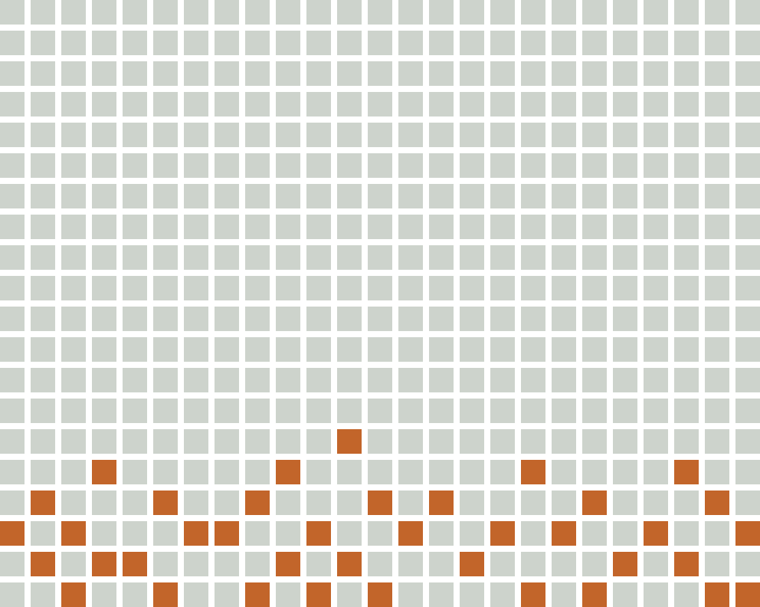
Re-check only what can change
INCREMENTAL UPDATES
39 of 500
plots re-checked in 0.11 s after one release: the exact set that can change, since events land only on 2020-forest cells. 12 final statuses change.
Fits their reanalysis
Users still choose when to reanalyse; we name exactly which lots a release can affect. Dated events let a lot be checked only against events before its harvest.
Re-checked (39)
Untouched (461)
Trade-off
Low-confidence RADD alerts can be retracted later: that needs “retract” events (designed, not built). A quarterly fold-in rebuilds the base.
Grid is illustrative: one square per plot · 3,989 events, 22.7 kB in the release
11
Notes:
Reanalysis becomes targeted instead of guessed. Today SystemEarth’s users decide manually or by schedule which past lots to reanalyse, and sometimes skip it, for example when deforestation happened after the harvest. We don’t take that choice away: the affected-plot query tells them exactly which lots a release can change. And because every event carries a date, a lot can be checked only against events before its harvest date, which is the case their product manager raised. Demo: we built the store on data held back to 30 June, then published the last three months of RADD plus Hansen 2025 as one event batch: 3,989 events, 22.7 kB. The engine re-checked 39 of 500 plots in 0.11 seconds, exactly the set whose outputs can change. 12 final statuses changed, 9 of them from Compliant to Non-compliant. A full re-check gives the identical result. Why so few: events only happen on cells that were forest in 2020, and about 99% of ordinary cocoa plots touch no 2020 forest. Our 500 plots are stratified towards forest on purpose, so 39 of 500 is pessimistic for a real portfolio. Trade-off: low-confidence RADD alerts can be withdrawn later. That needs retract events, which are designed but not built. A quarterly fold-in rebuilds the base raster.

Slide 12
Now for the demo
LIVE PROTOTYPE
Notes:
Switch to the prototype here. When you're done, come back to the next slide: “And does it still match the raw layers? Yes, on every plot.” If the live run fails, don't debug on stage: play the recorded backup and move on.

Slide 13
Fix the rules first, then encode without loss
RESULT FIDELITY · RESULT AND RATIONALE
100%
100%
0 ha
248
decision fidelity: 500 plots, 5 strata, before and after the update
pixel fidelity on 32.4 M cells
area difference; every output field identical
Compliant in all 12 threshold settings
We chose | Why | Trade-off
One written spec, both pipelines | Fidelity only means something against fixed rules | The shared per-cell rule isn’t tested independently
Lossless encoding | Exact values: no quantised dates, no downsampling | Bigger than a lossy store would be
Pixel-centre rule; points → circles | Deterministic; EUDR lets plots up to 4 ha be points | Edge pixels count all or nothing
Nearest neighbour; Hansen year → 1 Jan | Never invents values; the earliest date is conservative | Some Hansen loss is dated early
100% = the store loses nothing vs the raw layers, not that the layers are right on the ground
13
Notes:
Fidelity, and how we made 100% mean something. The result: 100% decision fidelity on all 500 plots in all five strata, before the update, after the incremental update, and on a full re-check. Every output field is identical to the raw-layer pipeline, with zero area difference. 100% pixel fidelity on all 32.4 million cells. And thresholds are settings, not magic numbers: across 12 combinations of the 3-cell and 1% rules, the 248 Compliant plots never change; plots only move between Non-compliant and Needs review. The plots are synthetic but stratified over forest fragments, ordinary cocoa land, classified forests, the park boundary and the park interior, so every rule path is exercised. Why it holds. Before any encoding we wrote the decision spec, the contract both pipelines implement. The honest cost: both share the per-cell rule, so 100% proves the encoding, event log, index and SQL lose nothing; it doesn’t test the rule itself. We chose lossless encoding over quantised dates or downsampling. A pixel belongs to a plot when its centre is inside it; point plots, which EUDR allows up to 4 hectares, become circles of the declared area. Edge pixels count all or nothing, which is why Earth Engine’s forest-cell counts match on 81% of plots while the c2 verdict matches on all 500. Nearest-neighbour resampling never invents values, and Hansen’s year becomes 1 January, the conservative choice. Be precise: 100% means the compact store loses nothing compared with the raw layers. It does not mean the layers are right on the ground.

Slide 14
Reanalysis in minutes, not hours
RUNNING COST · RESULT AND RATIONALE
All of Ivory Coast, 1 M plots | Our design | Today
Storage | ≈ 0.17 GB, under $0.01/month (approx.) | Full raster copies in GCS + PostGIS vectors
Reanalysis of 1 M plots | ≈ 11 min local compute; ≈ $0 | ≈ 7 hours (0.5 s per request, 20-request cap); ≈ $19 of EECU
Fixed cost | Object storage + small batch job, under $1/month (approx.) | Enterprise Basic fee $500/month (incl. 33 online + 100 batch EECU-hours)
Earth Engine once per release
Files + a small batch job
Option: direct downloads
Per-check compute is cheap either way; the gain is time and no 20-request cap.
Nothing to keep running. Trade-off: a start-up cost on each run.
Hansen and GFC2020 are public files: could free the $500/month plan, if nothing else needs it.
Prices approximate; Earth Engine pricing read 14 Oct 2026 · extraction per release not yet measured
14
Notes:
The budget the organisers asked for, at national scale: all of Ivory Coast, a million plots. Say it straight: Earth Engine compute per check is cheap, about 19 dollars per million single-plot checks, 0.17 EECU-seconds at 40 cents per EECU-hour. Storage is cheap on both sides too. Don’t oversell savings: at measured rates Earth Engine usage is tens of dollars a month. The real differences are elsewhere. Time: at half a second per request and a cap of 20 concurrent requests, reanalysing a million plots takes about 7 hours; our store does it in about 11 minutes on one core. No concurrency cap. Targeted reanalysis. And the check path no longer needs Earth Engine: we only use it to extract a release, and Hansen and GFC2020 are downloadable directly. That could free the 500 dollar a month Enterprise Basic plan, 6,000 a year, if nothing else at SystemEarth needs it, which we don’t know. What we haven’t measured yet is the cost of extracting a national release. Engineering time, not the cloud bill, is the real cost of our design. If asked about supplier declarations: simulating the sample supplier’s method (any Hansen loss 2021–2023), we agree on c2 for 75.6% of the stratified plots. 76 supplier flags are removed, 69 of them on plots with no 2020 forest; 46 times the supplier misses something, 32 RADD alerts and 14 losses after 2023.

Slide 15
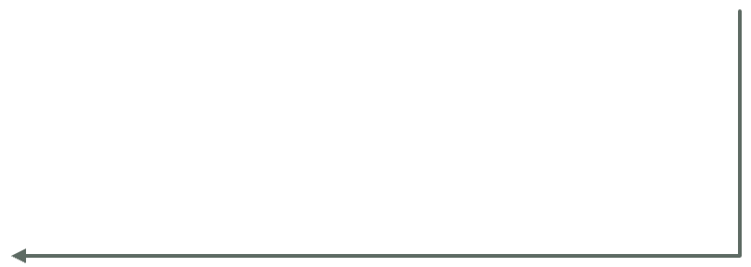
It slots into SystemEarth’s stack
SYSTEM DESIGN · IN PRODUCTION (PROPOSED)
KEPT
NEW
NEW
Earth Engine / downloads
Release job
Compact store, in GCS
Source layers, once per release
Extract → encode → event file
Base raster · event files · manifest · plot index
KEPT
NEW
Plain files in object storage, beside their rasters
PostGIS
Indexer
Plots and lots
On upload: cell runs + park overlaps
KEPT
NEW
Results + audit trail
Check engine
Verdicts tagged with manifest ID
DuckDB; on demand or scheduled
National scale, estimated: layers ≈ 16 MB · plot index ≈ 148 MB for 1 M plots · full re-check ≈ 11 CPU-minutes · GeoServer maps unchanged
Proposed deployment · stack per SystemEarth PM, 14 Oct 2026
15
Notes:
This is how it would run at SystemEarth: a proposal, built around what they already have. Blue is kept. Earth Engine, or direct downloads, still supply the source layers, but only once per release. PostGIS stays the home of plots and lots. Verdicts go back into their results and audit trail, each tagged with our manifest ID next to their own dataset versions. Orange is new, and it is three small jobs and some files. A release job extracts and encodes each release into a new event file. An indexer runs when a lot is uploaded, turning plots into cell runs and storing park overlaps. A check engine runs DuckDB over the store, on demand or on the schedule users already choose. The compact store is plain files in object storage, in the same Google Cloud Storage they already use for rasters. No database server to run. At national scale, estimated from our per-square-kilometre and per-plot figures: about 16 MB of layers, about 148 MB of plot index for a million plots, and about 11 CPU-minutes for a full re-check. GeoServer and their maps are untouched. This is the target state of the migration path on the next slide: run alongside, compare verdicts plot by plot, then switch reanalysis over.

Slide 16
What we chose, where it stops, how to adopt it
TRADE-OFFS AND NEXT STEPS
What we chose
Where it stops
How to adopt it
The satellite’s own pixel grid
Today’s rule only
1
Run alongside Earth Engine
so plot edges match exactly
new questions mean re-extracting
no change for users
16 bits per cell
Simulated test plots
2
Compare verdicts
one small read per plot
no field data yet
plot by plot
One small file per data release
One 50 km area tested
3
Switch re-checks over
re-check only what changed
per-km² figures scale
to the compact store
Plots stored as cell runs
Withdrawn alerts
4
Keep Earth Engine
no geometry at check time
designed, not built
for extracting each release
DuckDB on plain files
Prices are estimates
no server to run
the conclusion holds even if 10× off
Thresholds as settings
Compliant plots held across 12 settings
Keep the decision, not the data
16
Notes:
Every choice has a reason. Pixel grid, not H3: hexes don’t align with pixels, so plot membership would change and pixel fidelity would break. 16-bit packed base: one tile read per plot. Event log: incremental re-checks. Run-length index: 70 kB instead of 977. DuckDB: no cluster to run. Thresholds as settings: Compliant never moves. Limits, said before a judge says them: the store answers today’s rules only; the plots are synthetic; we tested one 50 km area, but the per-square-kilometre figures scale; retraction events are designed, not built; prices are approximate. Adoption is low risk: run our checks alongside Earth Engine, compare verdicts plot by plot, then switch re-checks over. Earth Engine stays for extracting each release. The end state is the stack on the previous slide.

Slide 17
Keep the decision, not the data.
43×
32 ms
39 / 500
100%
smaller store
per plot check
plots re-checked per update
decision fidelity
Rafael · rafael-macam.vercel.app · Questions welcome
Notes:
Close on the line, then the four numbers in one breath: 43 times smaller, 32 milliseconds per plot, 39 of 500 re-checked on an update, 100% decision fidelity. Then stop and take questions. The appendix slide has prepared answers; the full v1 deck has the deeper design slides if a judge wants detail.

Slide 18
What 100% does and doesn’t prove
APPENDIX · QUESTIONS ON FIDELITY
Question | Answer
100% because you share code? | Shared: the spec’s per-cell rule. Verified independently: encoding, events, index, SQL rules
Both pipelines share one pixel rule, so edges can’t disagree? | Exactly: fixing one rule in the spec makes fidelity achievable. Between systems the risk is real: Earth Engine’s edge handling changed forest counts on 19% of plots
Then why are small plots the hard case? | That’s where a vague rule breaks verdicts: a third of a 1 ha plot’s cells sit on its edge
Synthetic plots? | Stratified so every rule path runs; landscape rates come only from 5,000 random plots
Why 3 pixels? | A setting: Compliant stays at 248 across all 12 threshold settings
Does 100% mean the verdicts are right? | No: the store loses nothing vs the raw layers; it says nothing about the layers on the ground
Backup · show only if asked
A1
Notes:
Backup slide, show only if asked. Shared pixel rule, full answer: “Exactly. Fixing one pixel rule in the spec is what makes fidelity achievable. The risk is real between systems: Earth Engine’s own edge handling changed forest-cell counts on 19% of our plots, even though the c2 verdict matched on all 500. Small plots are where a vague rule breaks verdicts, and that’s why we wrote the rule down first.” What 100% verifies independently: the encoding loses nothing (packing, compression, tiles), the event log reproduces the full data, the run-length index is exact, and the rules re-implemented in SQL match the Python rules. It says nothing about whether GFC2020 or RADD are right on the ground. Thresholds: across 12 combinations of the 3-cell and 1% edge rules, the 248 Compliant plots never change; plots only move between Non-compliant and Needs review. They decide how much goes to a person, never whether a plot is cleared.

Slide 19
Why each layer and rule is the way it is
APPENDIX · QUESTIONS ON DATA AND THE RULE
Question | Answer
Isn’t GFC2020 wrong on shade cocoa? | Sometimes (18% commission error in v2); uncertain plots go to review
Why drop all data before 2021? | The cut-off is fixed in EUDR Art. 2; earlier loss can’t change the verdict. The 2020 map keeps the one fact needed
Why resample Hansen to the 10 m grid? | Exact 3 × 3 alignment with GFC2020; it adds no information and compresses away
Why not H3? | Hexes don’t align with pixels; plot membership would change
What about retracted RADD alerts? | Not in the demo: needs “retract” events (designed, not built); a quarterly fold-in rebuilds the base
Classified forests only “review”? | Legally restricted but heavily farmed: a legality question for a person
Backup · show only if asked
A2
Notes:
Backup slide, show only if asked. Shade cocoa: GFC2020 can map shade cocoa as forest; its version 2 assessment found an 18% commission error. That’s why it’s a risk signal: one or two disturbed cells or low-confidence alerts go to review rather than straight to Non-compliant. Pre-2021 data: the cut-off is 31 December 2020 in Article 2. Loss before it can’t change a deforestation result; the 2020 forest map keeps the one fact we need from before. Hansen resampling: each 30 m Hansen pixel becomes exactly 3 by 3 GFC2020 cells by nearest neighbour, so nothing is invented and it compresses to almost nothing once masked to 2020 forest. Protected areas, if asked: we use national WDPA designations only; the Taï World Heritage record lies inside the national park, so adding it would only double count.

Slide 20
What the numbers do and don’t claim
APPENDIX · QUESTIONS ON PERFORMANCE, COST AND SCOPE
Question | Answer
Earth Engine is cheap per check. Why switch? | True: ≈ $19 per million. The win: ≈ 7 h → ≈ 11 min, no 20-request cap, targeted reanalysis
EE timings from a noncommercial project? | Same compute metering; latency on a commercial setup may differ, so we quote the median and range
Your area is small. | We report per-km² and per-plot figures so it scales; national numbers are labelled estimates
Are the prices verified? | Approximate and marked; the conclusion holds even if they’re 10× off
What about supplier declarations? | Simulated the sample supplier: 75.6% agree; 76 flags removed, 46 misses found
We already record versions. What’s new? | Agreed, and our manifest ID joins your audit trail. The new part is speed and targeted reanalysis
Backup · show only if asked
A3
Notes:
Backup slide, show only if asked. Earth Engine timings: our project is on the noncommercial tier. EECU metering is the same, so the compute figures carry over; latency on their commercial or high-volume endpoint may differ, which is why we quote the median of 20 requests and the full range, 0.40 to 6.9 seconds. Supplier declarations, in full: we simulated the sample supplier’s method, any Hansen loss 2021 to 2023, on our 500 stratified plots. We agree on c2 for 75.6%. 76 supplier flags are removed, 69 of them on plots with no 2020 forest at all; 46 times the supplier misses something, 32 RADD alerts outside their layer and 14 losses after 2023. Say “removes”, never “proves false”: we have no field data. Unmeasured, if asked: the Earth Engine cost of extracting a national release. If they ask about the demo, the recorded backup runs: build on data held back to 30 June, check 500 plots, a new release arrives, only 39 plots re-checked, results identical to the raw-layer pipeline, tests pass.

Slide 21
Over a plot’s lifetime, the geometry is solved once
APPENDIX · QUESTIONS ON PLOT UPLOAD AND LIFECYCLE
Moment | SystemEarth today | Our design | Who’s better
New plot, first check | Earth Engine overlays the polygon: about 0.5 s | Index once, then check: tens of ms | Marginal: both fine for one lot
Bulk upload | 20-request cap: ≈ 7 h per million (≈ 4.4 h batched) | ≈ 0.67 ms per plot: ≈ 11 min per million, one core | Ours, at scale
Every later reanalysis | The geometry overlay re-runs in Earth Engine | Lookups on stored cell runs; no geometry | Ours: done once
A new data release | Users pick lots manually or by schedule | Events × index name the affected plots (39 of 500) | Ours: the main point
Only events before harvest | A fresh Earth Engine analysis | Filter dated events against the plot’s cells | Ours
A rule setting changes | Re-run every plot on Earth Engine | Re-run locally in seconds | Ours
Plot edited or deleted | Handled by their audit trail | Must re-index or remove, triggered from their trail | Theirs is simpler
Trade-off: one more component to keep in sync. Drive the indexer from their upload flow and audit trail, and refuse an unindexed plot rather than skip it.
Backup · show only if asked
A4
Notes:
Backup slide, show only if asked: “What does this change when a supplier uploads a plot?” Concede the small point first; it makes the big one credible. How to say it: “For a single new plot, Earth Engine is fine: half a second either way. The difference is the plot’s lifetime. Today every reanalysis repeats the geometry work on Earth Engine, and users guess which lots a release affects. We index a plot once, at upload, so every later check is a lookup, and each release tells you exactly which lots it touched. The cost is keeping the index in step with your plot records, which your audit trail already makes easy.” The honest trade-off: we add an index that must stay in step with their plots. If a plot edit doesn’t reach the indexer, checks would run against the old shape. So it should be driven by their upload flow and audit trail, and an unindexed plot must be refused, not silently skipped; that’s a gap in the prototype today. What we get: the geometry is solved once, so every later question about that plot is cheap, including the one their users currently guess at: did this release change anything for this lot? Audit of plot history, if asked: equal. Theirs is already strong (versions, supply-shed versions); we rely on it and add our manifest ID per verdict. Numbers: single Earth Engine request ≈ 0.5 s median; ours ≈ 32 ms per check plus a one-off index step. A million plots: ≈ 7 hours one request at a time under the 20-request cap, ≈ 4.4 hours batched (7.9 s per 500), ≈ 11 minutes for us on one core.

Slide 22
Why DuckDB and not something else
APPENDIX · QUESTIONS ON THE CHECK ENGINE
Alternative | Why not
PostGIS (what SystemEarth has) | A database server that must run all the time; overkill for lookups over small, unchanging files
Earth Engine | Remote, about 0.5 s per request, paid per use, 20 requests at once
Plain Python | Works (it’s how the raw pipeline does it), but the SQL version is a second, independent implementation of the rules, which is what makes the 100% fidelity check meaningful
What DuckDB gives us
SQL over plain files, in-process: no server to run, no request cap, 32 ms per check. Trade-off: one machine, and start-up is most of those 32 ms.
Backup · show only if asked
A5
Notes:
Backup slide, show only if asked: “Why DuckDB?” How to say it: “The store is a few small files that only change once per release, so we didn’t want a server. PostGIS would work, but it’s a database that has to run all the time for what are really lookups. Earth Engine is what we’re replacing on the check path: remote, half a second a request, 20 at a time. And plain Python would work too; it’s how our raw-layer pipeline does it. Writing the rules again in SQL gives us a second, independent implementation, and that is what makes the 100% fidelity result mean something.” If pushed on scale: DuckDB runs in-process on one machine. A full national re-check is about 11 CPU-minutes, so one machine is enough; most of the 32 ms is start-up that a long-running service would remove. PostGIS still stays in their stack as the home of plots and lots; we only take the per-check lookups off it.

Slide 23
The hard work is done before anyone asks
APPENDIX · QUESTIONS ON WHY IT’S FASTER
Reason | Earth Engine (today) | Ours | Effect
1. When the work happens | Every request redoes it all: which pixels fall in the farm, processing the full layers | Done once: farm cells at upload, layers condensed to 16 bits per cell at each release | A check is a lookup
2. Data touched | Full layers, several bands, combined on the fly; most compute goes on preparing pixels | About one tile, under 1 kB, already filtered to what the rule needs | Tiny reads
3. Where it runs | Google’s servers: a trip over the internet plus queueing, 0.4–6.9 s each | On the same machine as the files | No network wait
4. How many at once | At most 20 requests at once on the Basic plan | All farms in one query: 500 in 0.34 s, ≈ 0.67 ms each | No cap
Reanalysis multiplies it
Keep it honest
We also skip farms that can’t have changed: an update re-checked 39 of 500.
EE compute is small (≈ $19 per million). Batched it’s ≈ 4.4 h per million; we’re still ≈ 24× faster.
Backup · show only if asked · 11 min per million extrapolated from 500 farms, scales linearly
A6
Notes:
Backup slide, show only if asked: “Why is it so much faster?” Short answer: because the hard work is done before anyone asks, and checks run locally, in bulk. Earth Engine redoes the work on Google’s servers for every request, one request at a time, with at most 20 running at once. One line for the pitch: “Earth Engine redoes the work remotely for every request, 20 at a time. We do it once in advance, keep only what the rule needs, and check every farm locally in one pass, and after an update we only re-check the farms that could have changed.” An everyday comparison, if it helps: Earth Engine is like ordering each dish from a restaurant across town: every order is cooked from scratch, you wait for delivery, and they take only 20 orders at a time. Ours is meal prep at home: ingredients chopped in advance (farm cells at upload), kept in your own fridge (local files), and every dish cooked in one go (one query). After a delivery of new groceries you only remake the dishes that used them (39 of 500). Keep it honest: Earth Engine’s computing per check is small, 0.17 EECU-seconds, about 19 dollars per million checks. Most of its slowness is the round trip, the per-request setup and the 20-request cap, not heavy maths. Batched, Earth Engine is faster, about 16 ms per farm, so about 4.4 hours per million instead of 7; we’re still about 24 times faster. The 11 minutes is extrapolated from 500 farms at 0.67 ms each on one core; it scales linearly and can be split across machines.

